Slide 1
https://codeburst.io/algorithms-i-searching-and-sorting-algorithms-56497dbaef20

Slide 2
CSS143 Computer Programming (II)

Slide 3
Class Survey and Evaluation
Teaching Survey
https://tinyurl.com/prog-w20-post
Course Evaluation
https://uwb.iasystem.org/survey/21897

Slide 4
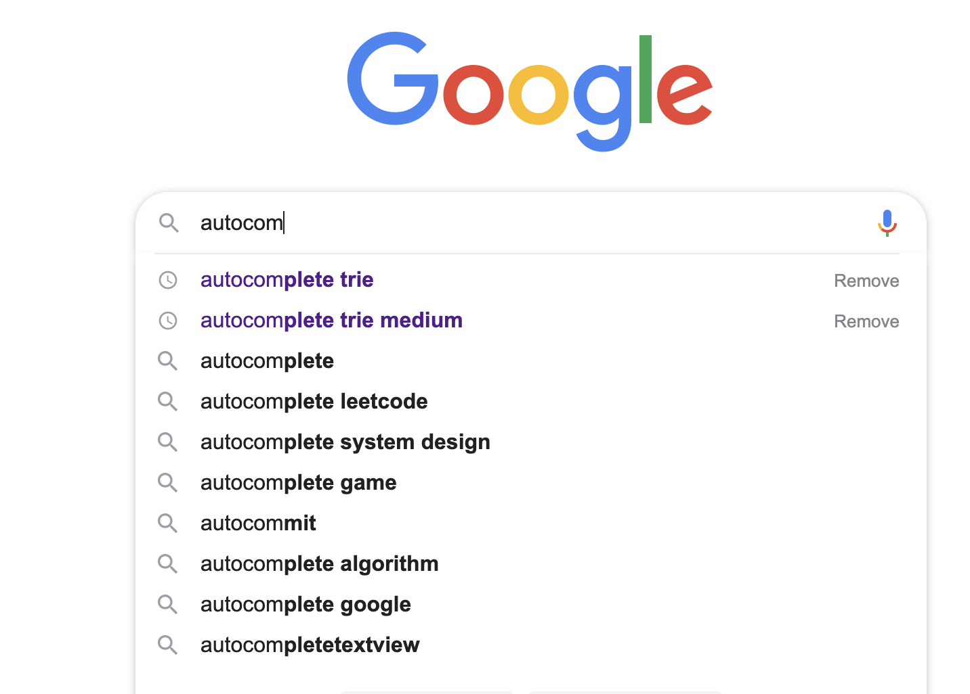
Autocomplete

Slide 5
Autocomplete
[
"hello",
"high",
"seattle",
"seatac",
"see",
"hollow",
"how”
“seaworld”
]
s
a
e
t
Seattle
Seatac
Seattle
Seatac
seaworld

Slide 6
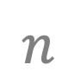
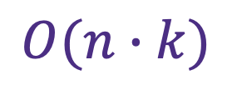

Autocomplete
s
a
e
Seattle
Seatac
[
"hello",
"high",
"seattle",
"seatac",
"see",
"hollow",
"how”
“seaworld”
]
seaworld
$$k$$
$$n$$
Idea 1: match each give str in the set one by one
$$O(n∙k)$$

Slide 7
Autocomplete
s
a
e
Seattle
Seatac
[
"hello",
"high",
"seattle",
"seatac",
"see",
"how”
“seaworld”
]
seaworld
Idea 2: Using Trie
retrieve
Pronounce “try”

Slide 8
Trie
s
[
"hello",
"high",
"seattle",
"seatac",
“how”,
"sea",
”set”,
“seaworld”
]
e
a
t

Slide 9
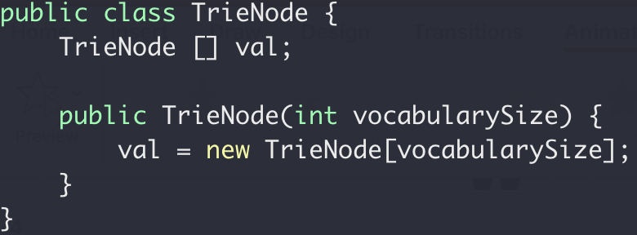
Trie
node
a
b
…
s
…
y
z
[
"hello",
"high",
"seattle",
"seatac",
"see",
"how”,
“seaworld”
]

Slide 10
Trie
a
b
…
s
…
y
z
[
"hello",
"high",
"seattle",
"seatac",
"sea",
”set”,
“how”,
“seaworld”
]
a
b
…
e
…
y
z
a
b
…
t
t
…
y
z

Slide 11

Trie
s
h
o
e
[
"hello",
"high",
"seattle",
"seatac",
"sea",
”set”,
“how”,
“seaworld”
]
e
i
a
t
l
w
g
t
-
l
t
a
h
l
o
c
e

Slide 12
Trie
s
h
o
e
e
i
s
a
a
t
e
l
w
Seattle
Seatac
g
t
sea
-
l
t
a
h
l
o
c
e

Slide 13
Trie
s
h
o
e
e
i
s
a
a
t
e
l
w
Seattle
Seatac
g
t
sea
-
l
t
a
h
l
o
c
e
Print all the paths from root
backtracking

Slide 14
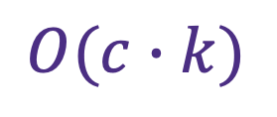

Trie
s
h
o
e
e
i
s
a
a
t
e
l
w
Seattle
Seatac
$$c$$
g
t
sea
-
l
t
a
$$O(c∙k)$$
h
l
o
c
e

Slide 15
Course Structure Review
Unit testing
Git/github
How to name your folders
ADT (array vs list)
One-dimensional ADT
Stack
Single linked list
Queue
Search Problem
Hash table
Recursion
Binary search tree
Binary tree
Heap
Trie
Sorting
multi-dimensional ADT
Algorithm Complexity

Slide 16
Review
Data Structure (ADT)
Interface vs Implementation
Complexity
CRUD (Create, Read, Update, Delete)
Time vs Space (No free lunch)
Big O, worse case

Slide 17
Review
Algorithms
Recursion
Heap vs Stack memory, call stack, stack overflow
Know where to go
Go all the ways
Try all the ways (backtracking)
Repeated subproblems
Relationship with stack ADT
Iterative
Overhead comparison

Slide 18
Problem Solving
Try better algorithms
Try better data structure

Slide 19
Coding
Readability
Comments for intention
Testability
Unit testing
Verify possible inputs
Verify possible code path
Has no tests → no correctness
Tests passed → possible correctness
Tests failed → possible correctness

Slide 20
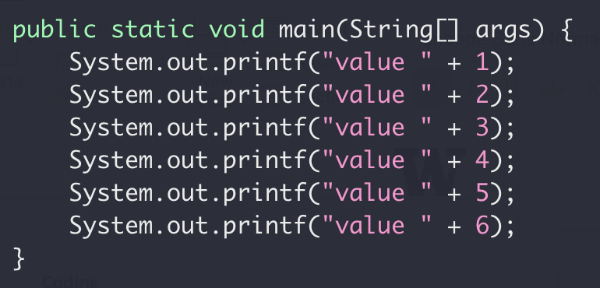
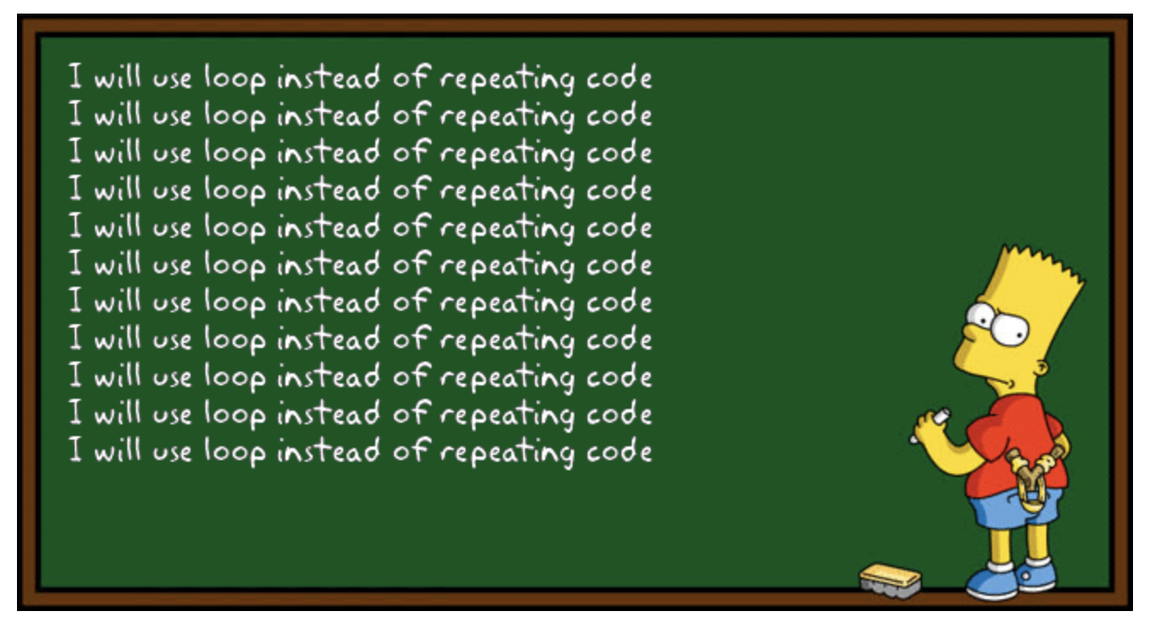
Coding

Slide 21
Source Control
Git everything!

Slide 22
Expectation Highlights
By the end of this course, you will:
Be comfortable with JAVA
Understand Object Oriented Programming
Be proficient with data structure like stack, queue, tree
Agree recursion is awesome but not always efficient
Have implemented your own text search engine
Not feel well writing code without git (source control)

Slide 23



Stay in touch

Slide 24
Final Exam
Monday 3/16 5:45pm – 7:30pm
Open book, no group work
Canvas submission
No late submission

Slide 25
Q.E.D.

